Slide 1
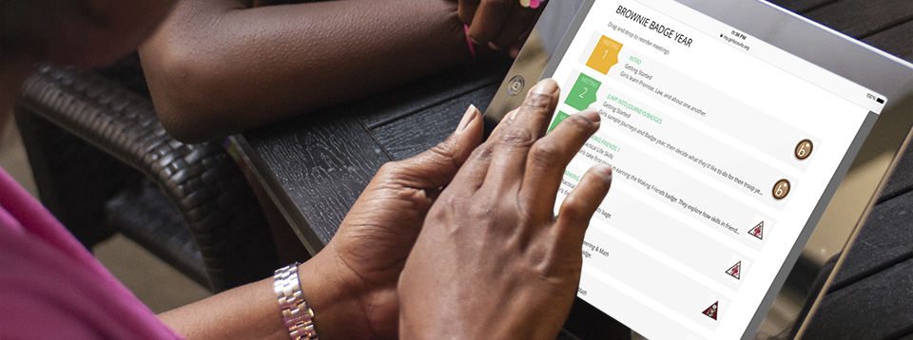
New Content and Functionality Enhancements in VTK
MY 2019
New Functionality Enhancements in VTK for MY 2019

Slide 2
What's New in VTK for MY 2019?
CONTENT
Super excited to have worked in partnership with Girl Experience, to provide the following NEW content in VTK for the 2019 Membership Year:
Cadette, Senior, Ambassador Content
  New! Not in PDF format! – Content available as interactive year plans and meeting plans!
  2 New! STEM Journeys
  2 New! STEM Badges
  New! Badge for Ambassador Troops
  New! Multi-Level (C,S,A/6-12) year plan tracks
Daisy, Brownie, Junior Content
  Brownie Quest (Classic Journey)
  Agent of Change (Classic Journey)
  Plus 4 New! STEM Badges
Details will be released
July 17th, 2018!

Slide 3
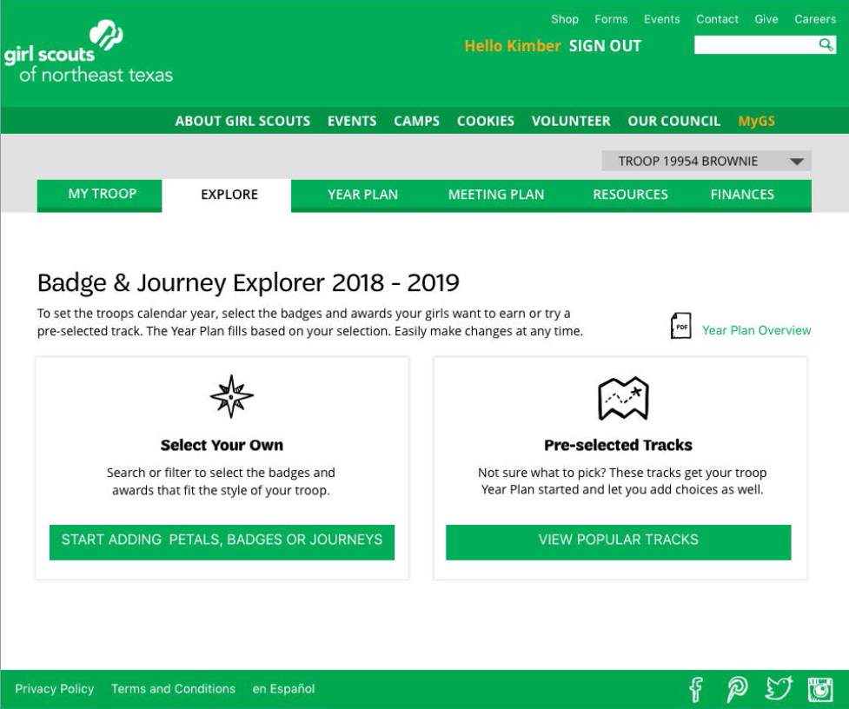
VTK MY 19 Enhancements:
NEW! Explore Tab
Explore Tab
Setting up your troop year just got easier. The new “Explore” tab lets you “Select your own” or use “Pre-selected Tracks” to jump start the Year Plan for your troop. New badge and award visuals let you see what your girls will earn.
Daisy through Ambassador and Multi-Level (K-5 & 6-12)

Slide 4
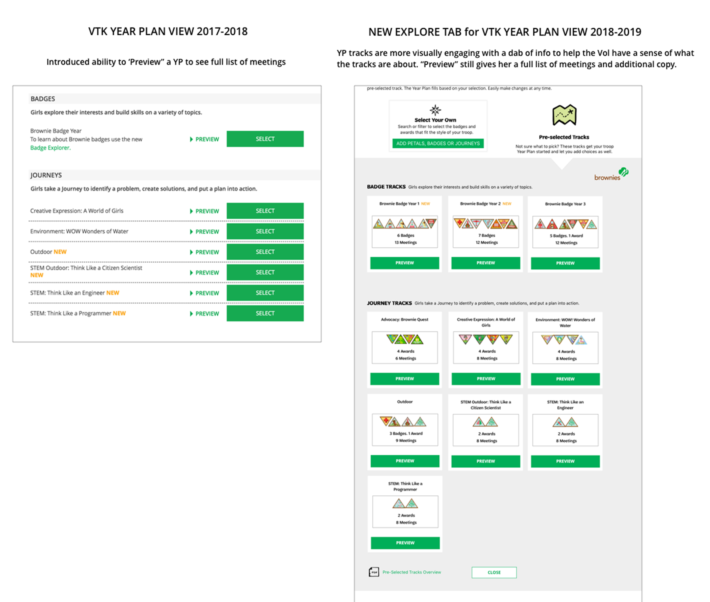
VTK MY 2019 Enhancements:
Newly Pre-populated Tracks—More Badge Options!
New! ADDITIONAL PRE-POPULATED BADGE TRACKS
Badge tracks have always been a popular Year Plan choice for troops. Several new badge tracks have been added across all grade levels.
Daisy through Ambassador

Slide 5
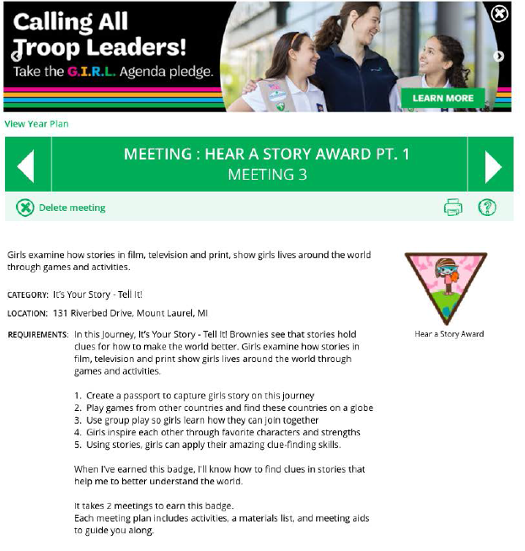
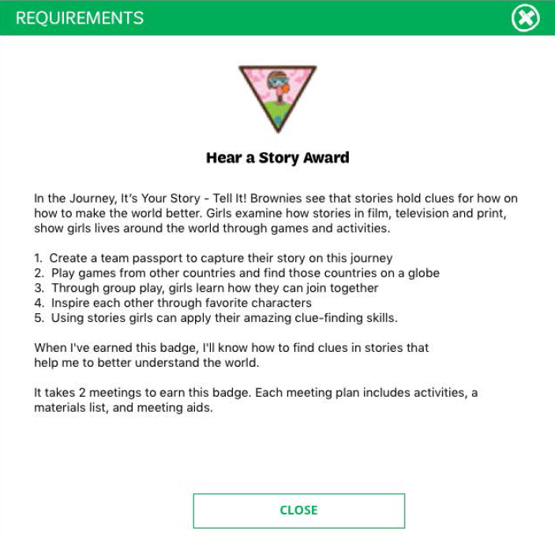
VTK MY 19 Enhancements
Badge Requirements Preview
New! BADGE REQUIREMENTS
Badge images are now active buttons that show you the requirements and steps to earn each badge.

